Slide 1
Database Indexing

Slide 2
Indexing
Indexes are used to speed up the retrieval of records in response to certain search conditions.
The index structures typically provide secondary access paths, which provide alternative ways of accessing the records without affecting the physical placement of records on disk.
They enable efficient access to records based on the indexing fields that are used to construct the index.

Slide 3
Indexing(Cont.)
A single-level index is an auxiliary file that makes it more efficient to search for a record in the data file.
The index is usually specified on one field of the file (although it could be specified on several fields)
One form of an index is a file of entries <field value, pointer to record>, which is ordered by field value
Indexes can also be characterized as dense or sparse.
A dense index has an index entry for every search key value (and hence every record) in the data file.
A sparse (or nondense) index, on the other hand, has index entries for only some of the search values

Slide 4
Types of Indexing
Types of Single-level Ordered Indexes
Primary Indexes
Clustering Indexes
Secondary Indexes
Multilevel Indexes
Dynamic Multilevel Indexes Using B-Trees and B+-Trees
Indexes on Multiple Keys

Slide 5
Primary Index
Defined on an ordered data file
The data file is ordered on a key field
Includes one index entry for each block in the data file; the index entry has the key field value for the first record in the block, which is called the block anchor
A similar scheme can use the last record in a block.
A primary index is a sparse index, since it includes an entry for each disk block of the data file and the keys of its anchor record rather than for every search value.

Slide 6
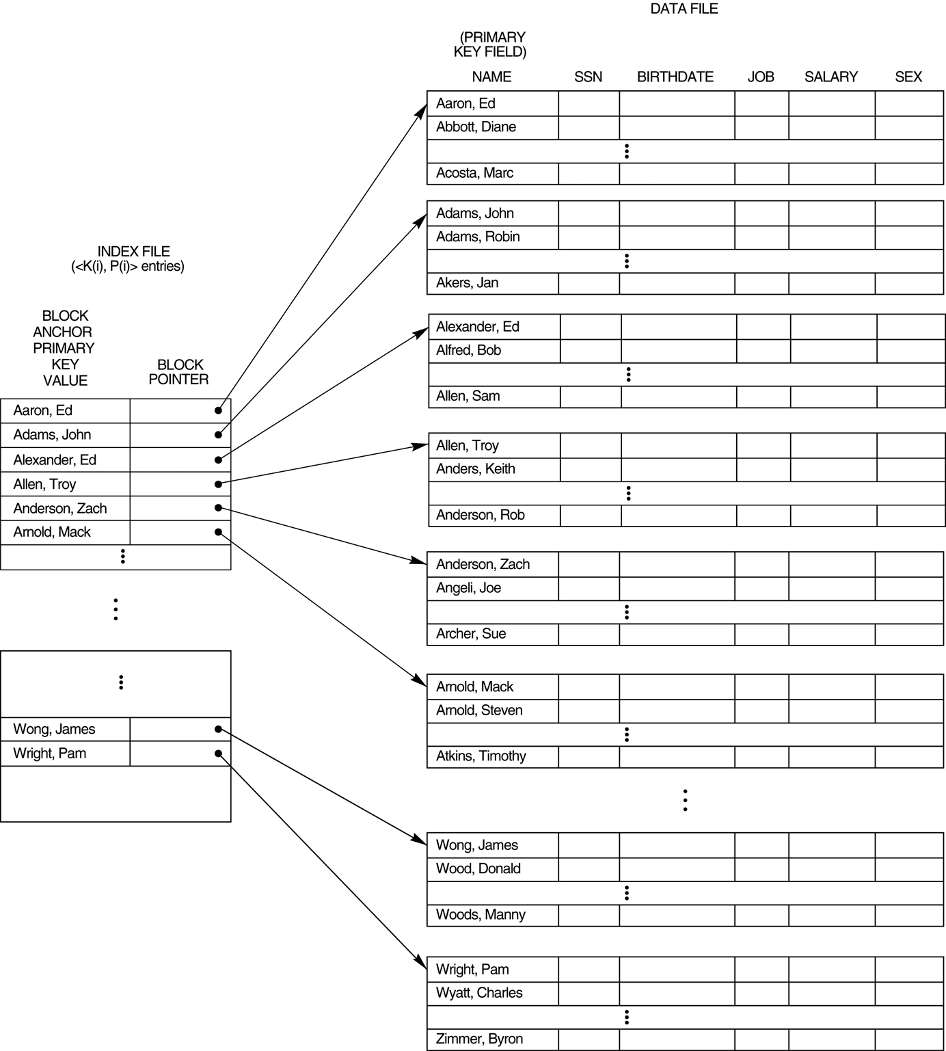

Slide 7
Clustering Index
Defined on an ordered data file
The data file is ordered on a non-key field unlike primary index, which requires that the ordering field of the data file have a distinct value for each record.
Includes one index entry for each distinct value of the field; the index entry points to the first data block that contains records with that field value.
It is another example of sparse index where Insertion and Deletion is relatively straightforward with a clustering index.

Slide 8
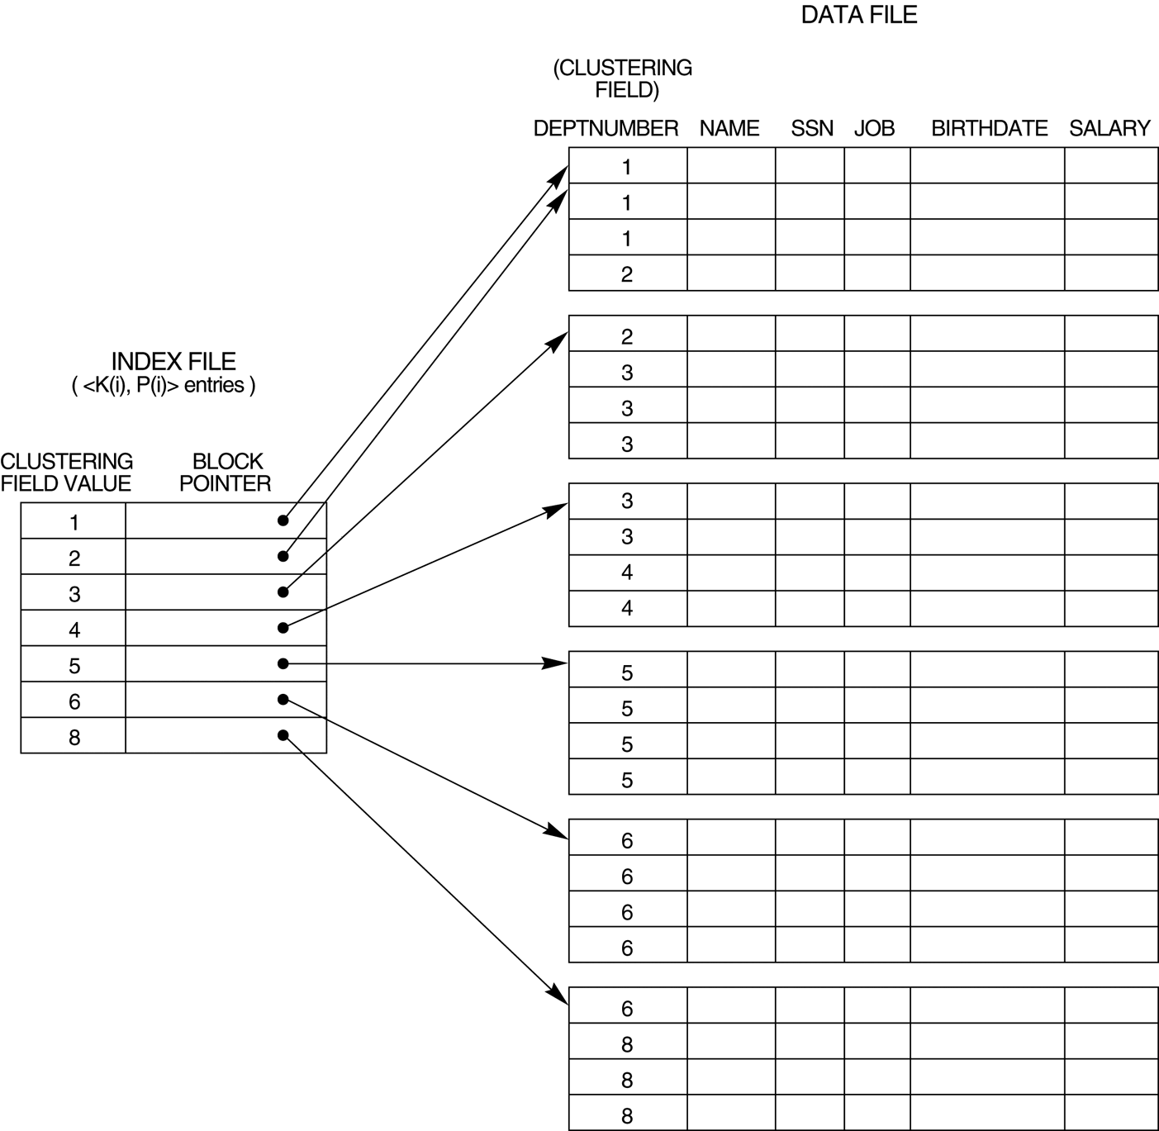

Slide 9
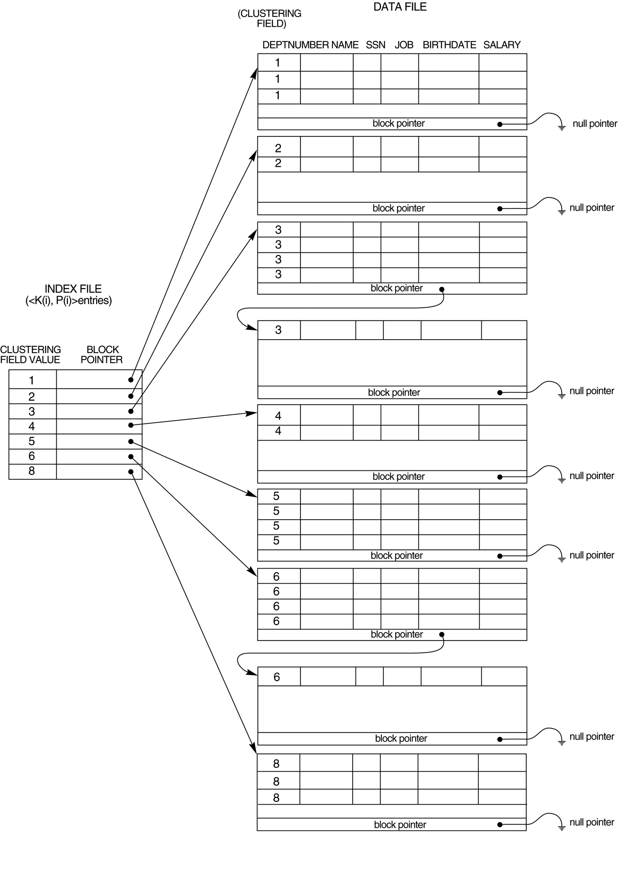
Clustering index with a separate block cluster for each group of records that share the same value for the clustering field.

Slide 10
Secondary Index
A secondary index provides a secondary means of accessing a file for which some primary access already exists.
The secondary index may be on a field which is a candidate key and has a unique value in every record, or a nonkey with duplicate values.
The index is an ordered file with two fields.
The first field is of the same data type as some nonordering field of the data file that is an indexing field.
The second field is either a block pointer or a record pointer. There can be many secondary indexes (and hence, indexing fields) for the same file.
Includes one entry for each record in the data file; hence, it is a dense index

Slide 11
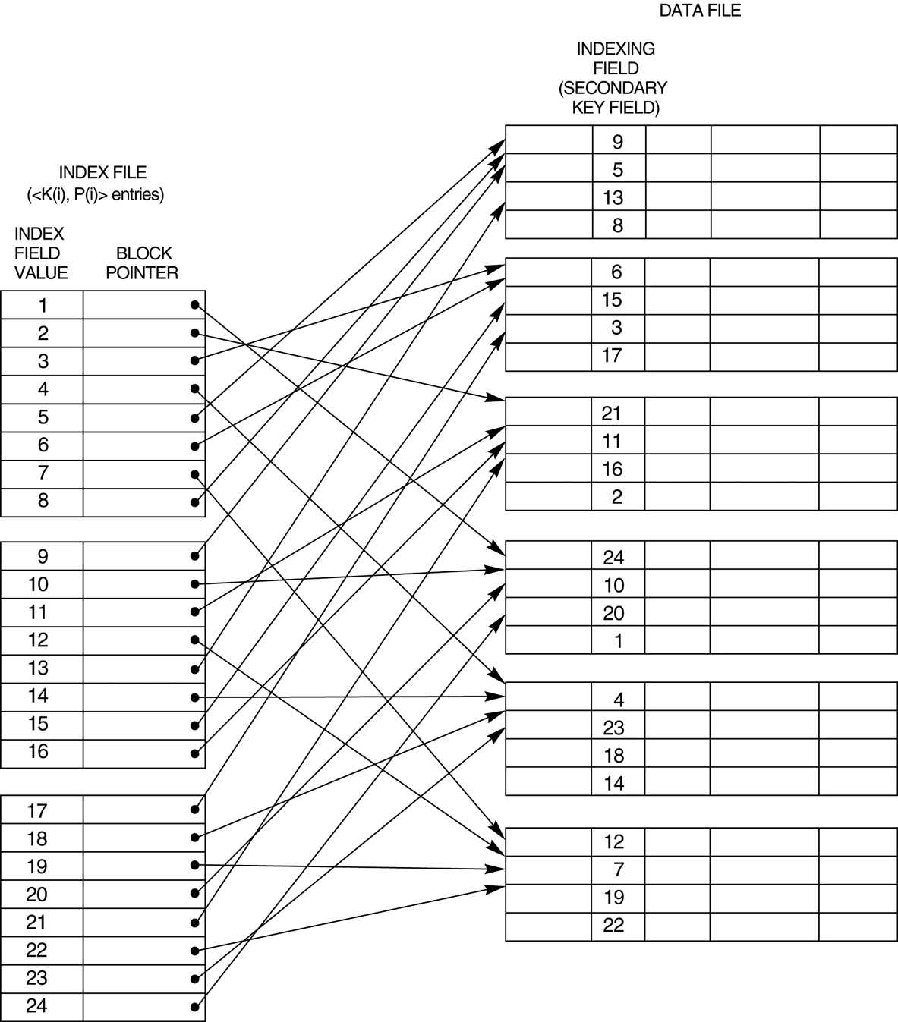

Slide 12
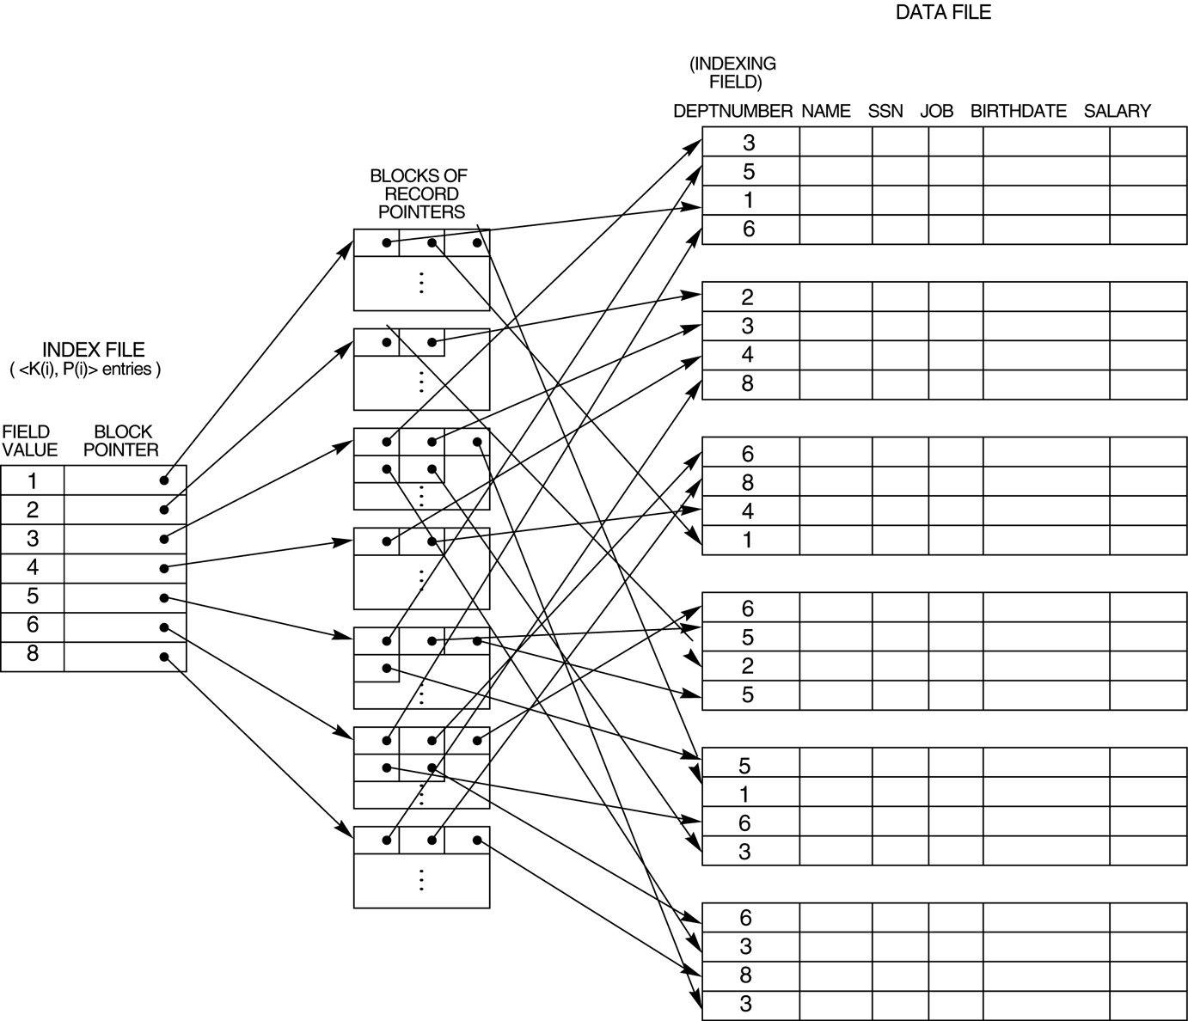
A secondary index (with recored pointers) on a nonkey field implemented using one level of indirection so that index entries are of fixed length and have unique field values.

Slide 13
Multi-level Index
The indexing can be divided into multiple levels in this case, the original index file is called the first-level index and the index to the index is called the second-level index and so on.
A multi-level index can be created for any type of first-level index (primary, secondary, clustering) as long as the first-level index consists of more than one disk block
In general, a multi-level index is a form of search tree.

Slide 14
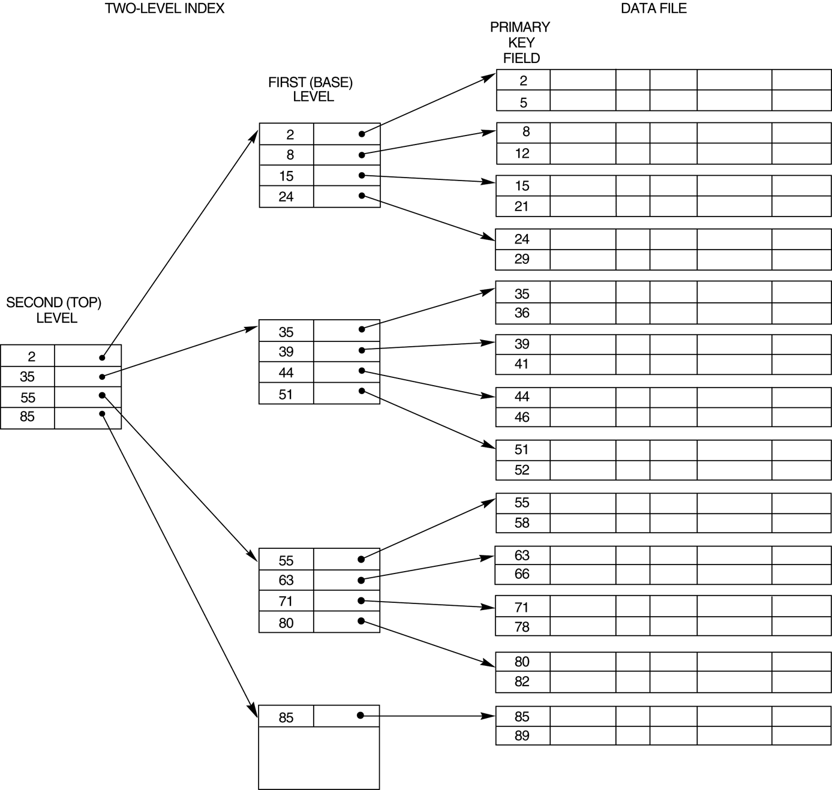

Slide 15
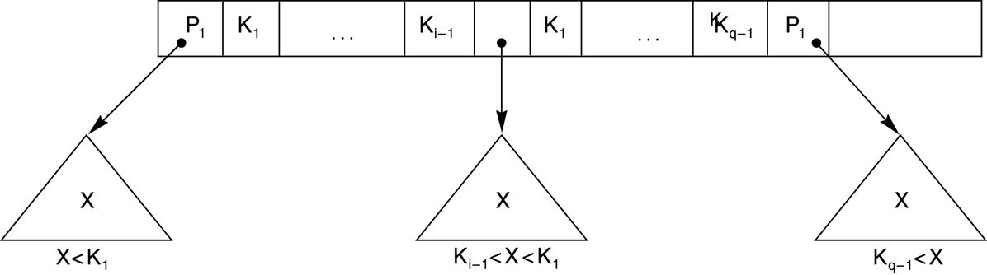
A node in a search tree with pointers to sub-trees below it

Slide 16
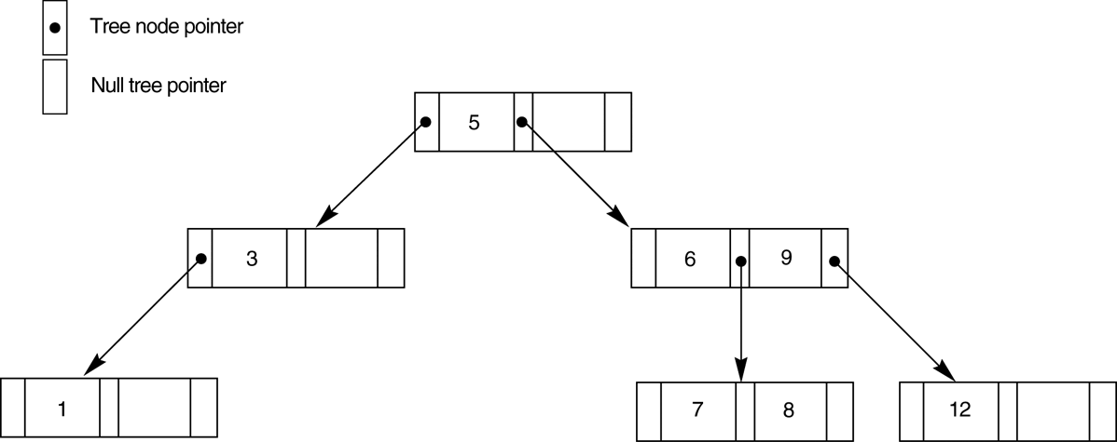
A search tree of order p = 3.

